Slide 1
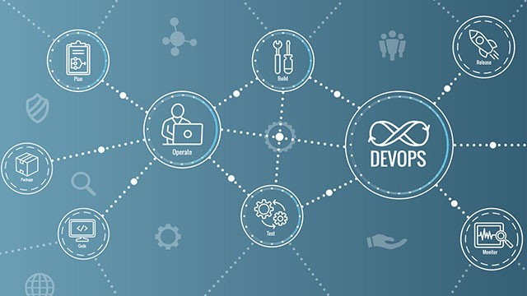

DevOps: E2E Automation
Project Leader -
Aman Jhagrolia
Team Members -
Mukta
Ashima Chopra

Slide 2


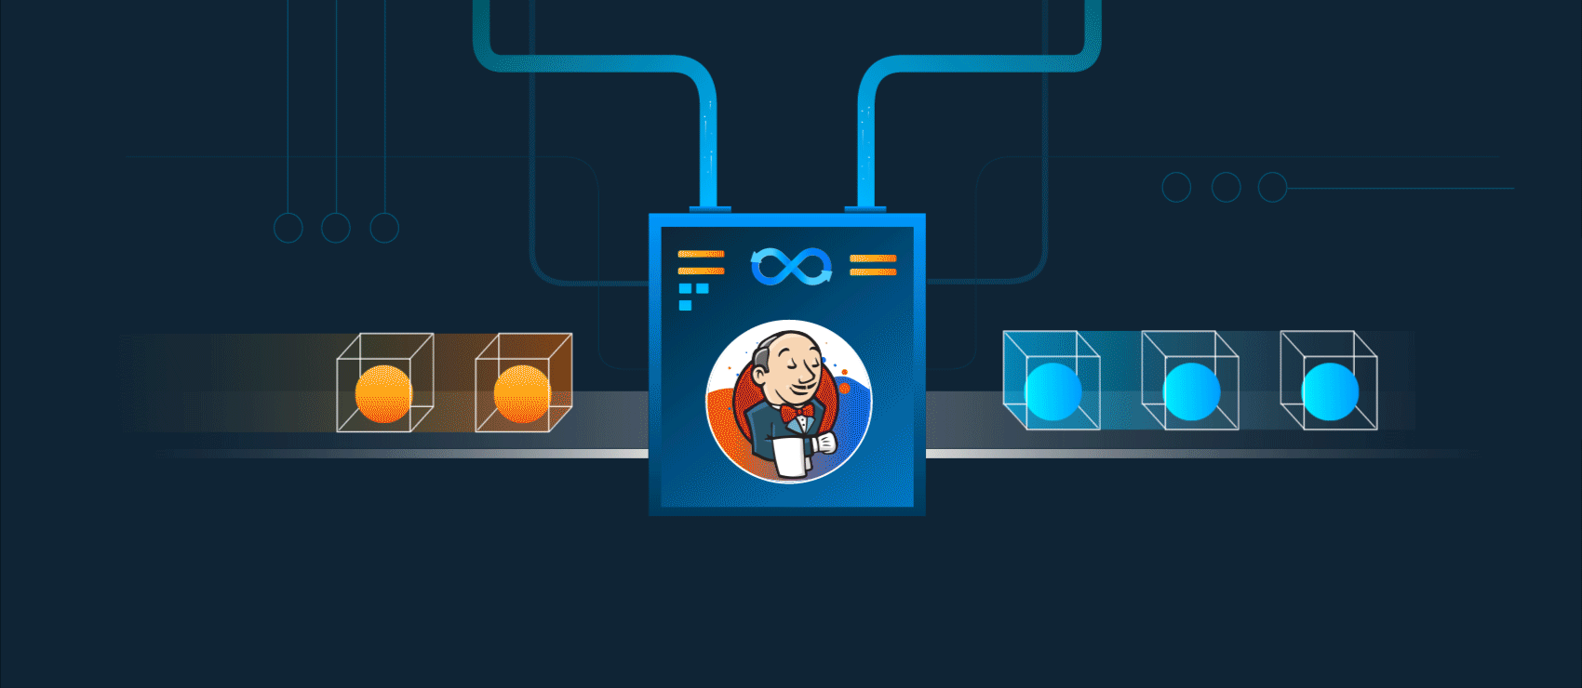
Project Description
In this project, we have created an end to end Jenkins pipeline for continuous integration, test, deployment, monitor and logging. The pipeline first builds the containerized application from the updated code that is pushed by the developer then that application is deployed on a testing environment and then if the test is successful it is deployed on the production environment and then continuously monitored and scaled up and scaled down depends upon the load.

Slide 3
Intro to DevOps
DevOps = Development and Operations
DevOps is a set of practices that combines software development (Dev) and IT operations (Ops)
DevOps is not a tool or a team, it is the process or a methodology of using various tools to solve the problems between Developers and Operations team
In short it breaks down the the silos between the Developers and Operations team in a Company

Slide 4
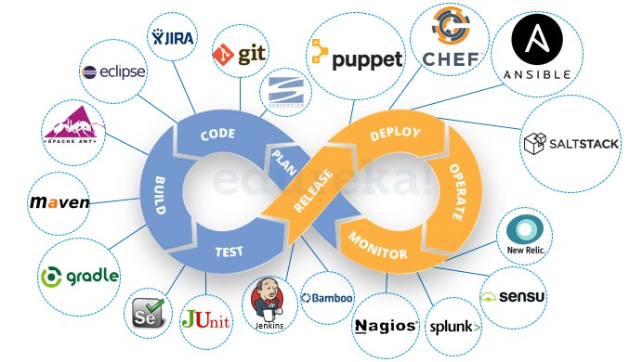
DevOps Lifecycle

Slide 5
Technologies Used
Jenkins - It is a free and open source automation server. It helps automate the parts of software development related to building, testing, and deploying, facilitating continuous integration and continuous delivery.
Kubernetes - It is a container-orchestration system for automating computer application deployment, scaling, and management.
Ansible - It’s an open-source software provisioning, configuration management, and application-deployment tool enabling infrastructure as code.
AWS EC2 and AWS EKS - The Jenkins server is running on the Amazon EC2 Instances and Amazon EKS is used for managed Kubernetes cluster.
Git/Github - Git is software for tracking changes in any set of files, usually used for coordinating work among programmers collaboratively developing source code during software development and GitHub is a provider of Internet hosting for software development and version control using Git.
Prometheus - It is a free software application used for event monitoring and alerting. It records real-time metrics in a time series database.
Grafana - It is a multi-platform open source analytics and interactive visualization web application. It provides charts, graphs, and alerts for the web when connected to supported data sources.
Elastic Search - It is a search engine tool which provides a distributed, multitenant-capable full-text search engine with an HTTP web interface and schema-free JSON documents.
Filebeat and Metricbeat - Filebeat is a lightweight shipper for forwarding and centralizing log data. Metricbeat is a lightweight shipper that you can install on your servers to periodically collect metrics from the operating system and from services running on the server.
Kibana- It is a data visualization dashboard for Elasticsearch.
Slack - It is a channel-based messaging platform.

Slide 6
DevOps Pipeline
To implement DevOps in any organization, we need to create DevOps pipeline
A pipeline in software development consists of set of tools, flows, and automated processes, enabling teams to leverage technologies to build and deploy software.
There can be different pipelines like Build, Integration, Test, Deployment etc.
CI/CD Pipelines -
Continuous Integration – Merge code in a central repository
Continuous Deployment — Configuration and Infrastructure management

Slide 7
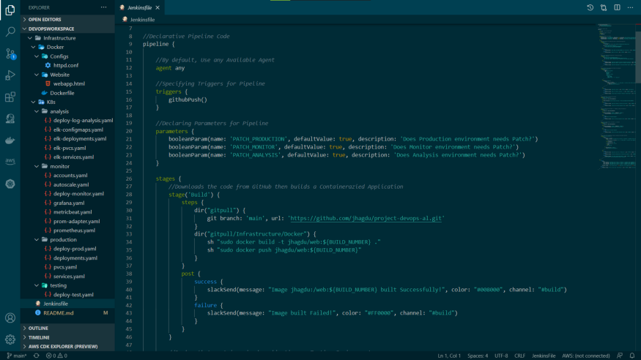
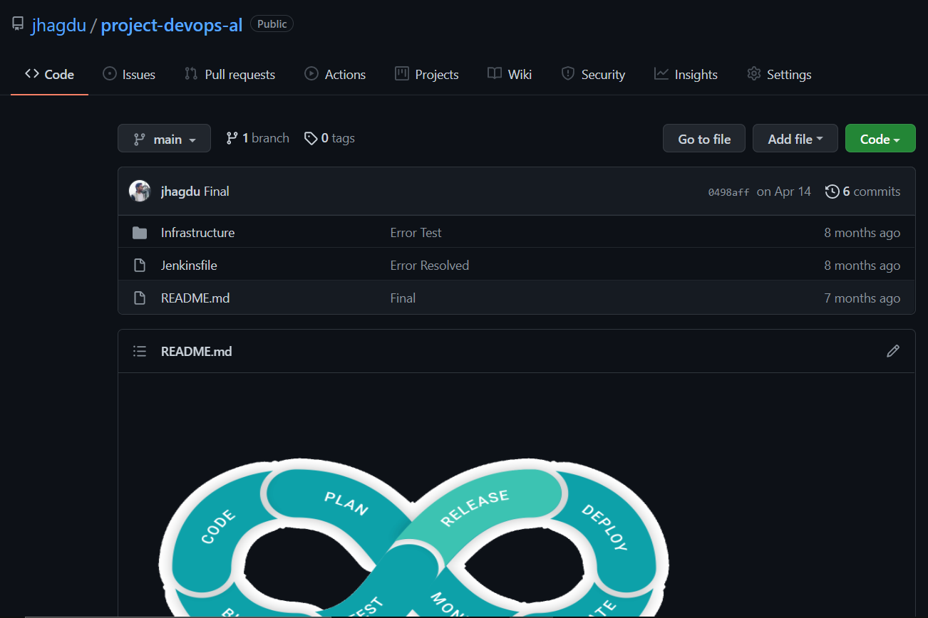
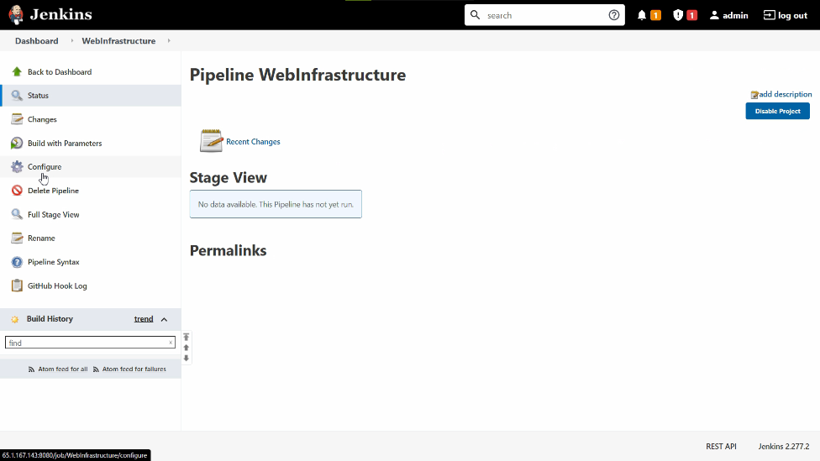
Project Startup
3. Create a Pipeline
1. Write Code
2. Push to Github

Slide 8
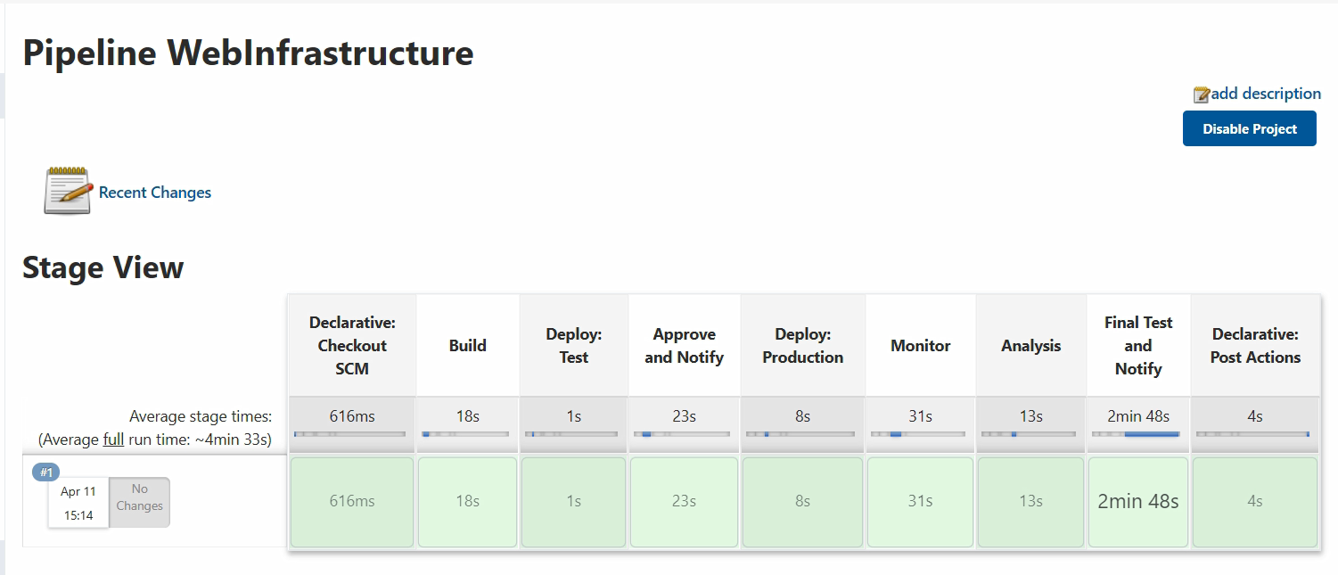
7 Stages of our Pipeline
Build: Downloads the code from GitHub, Builds a Containerized Application, Publish it to a centralized container registry
Deploy: Test: Deploy that containerized application on Testing Environment
Approve and Notify: Test and Approve the application and Notify the Developers
Deploy: Production: Deploy the application to Production Environment if Approved
Monitor: Deploy the Monitoring Environment i.e. Prometheus, Grafana, Metricbeat, etc
Analysis: Deploy the Logging analysis Environment i.e. EFK Stack and EMK Stack
Final Test and Notify: Take a Final Test on Application running in production Environment and Notify

Slide 9
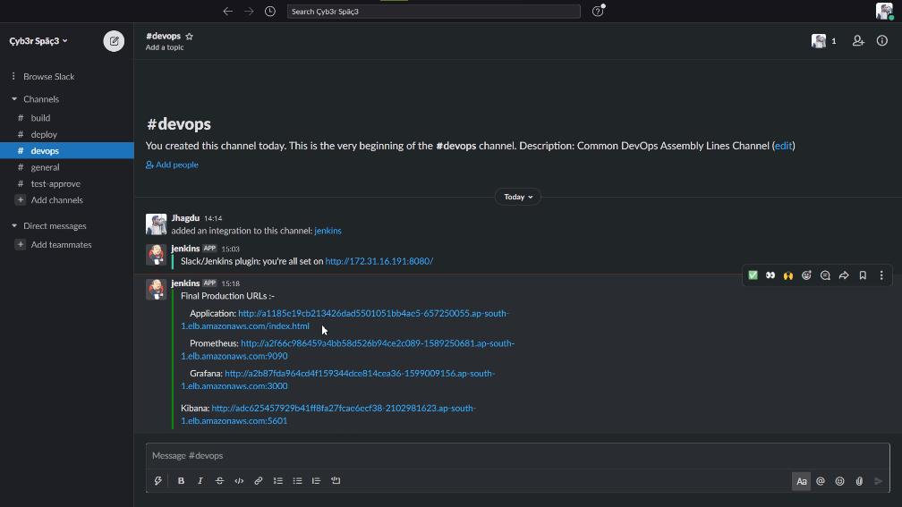
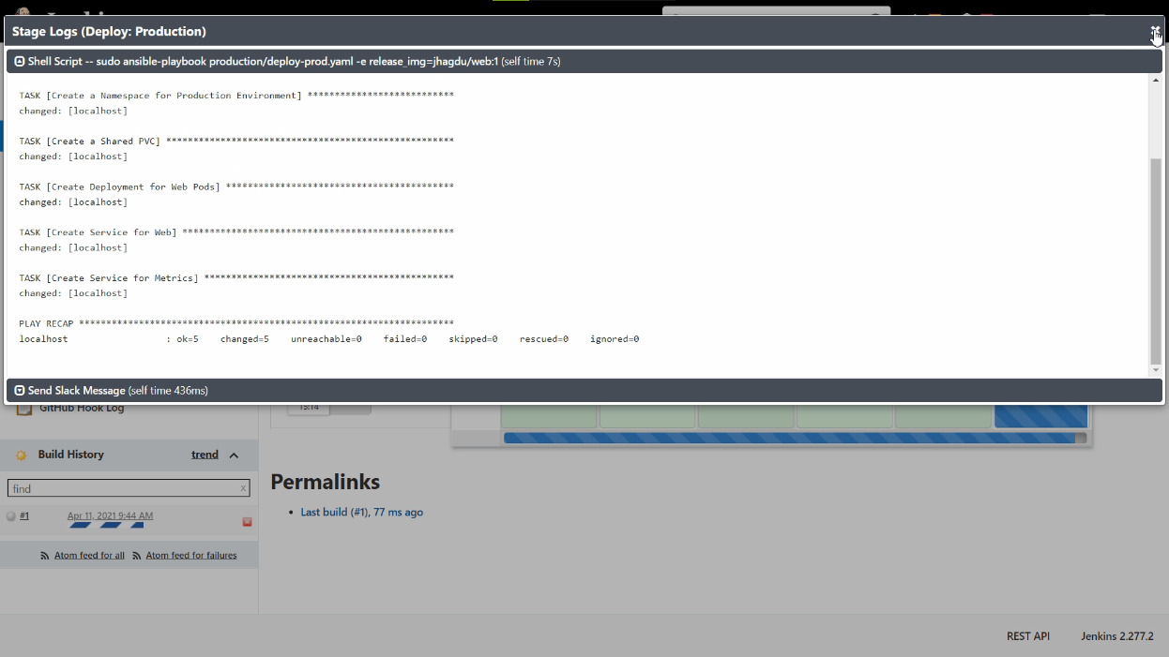
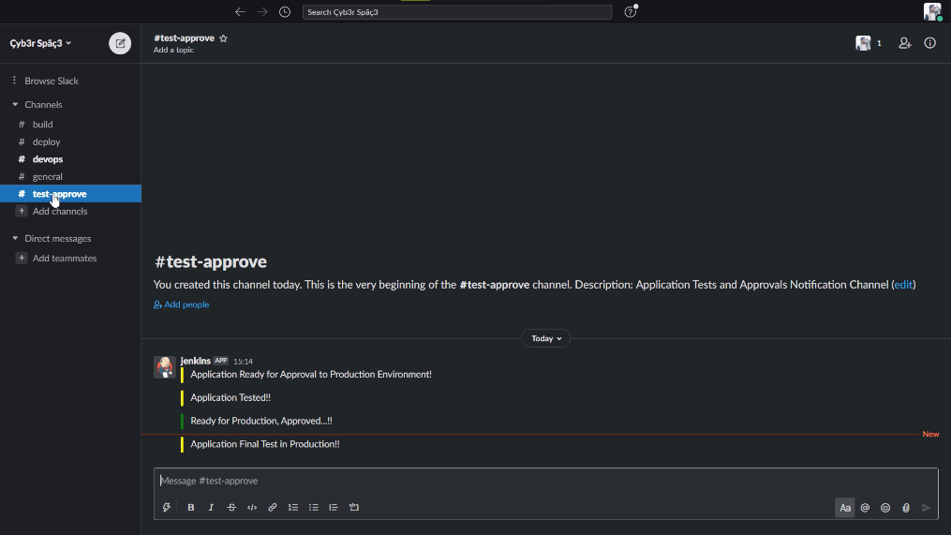
Deployment in Progress
As soon as developer push code to github repository, our Jenkins pipeline will be triggered and it will run the ansible for deployment and also notify the teams on slack.

Slide 10
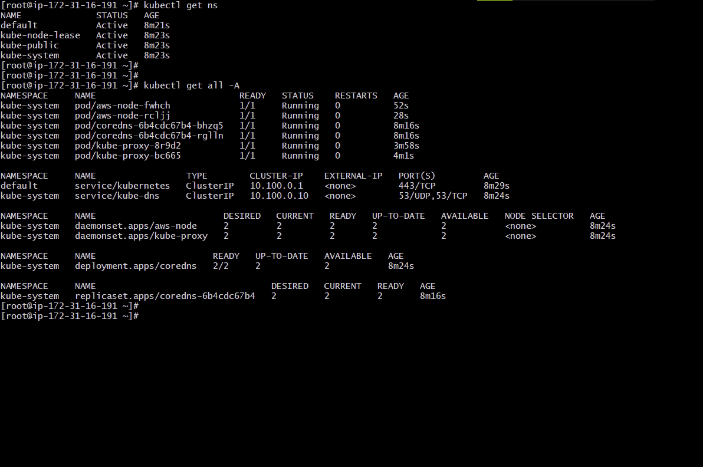
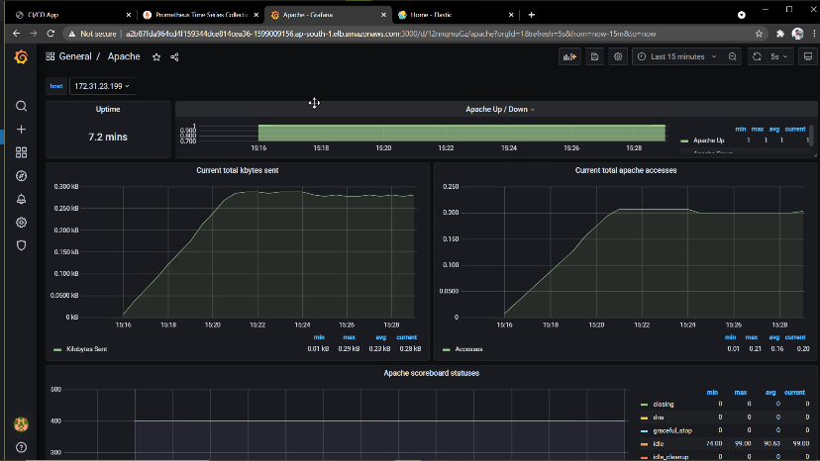
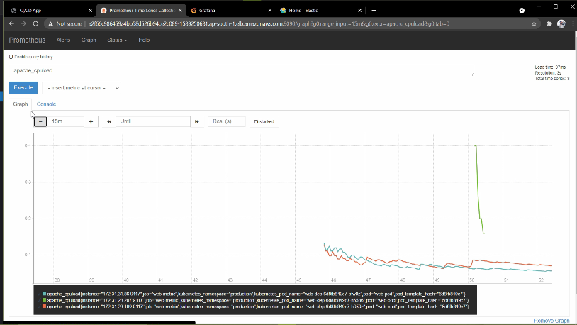
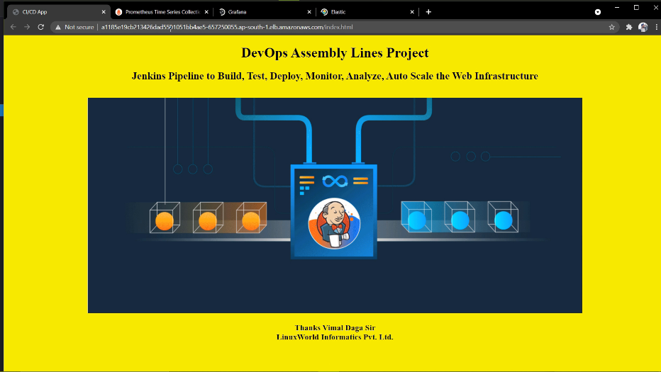
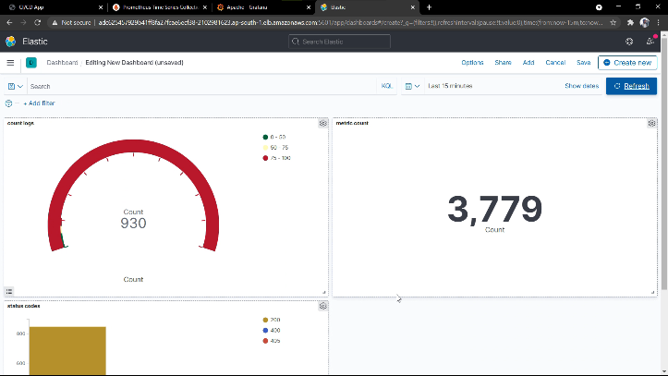
Deployment Done
When pipeline completes, all the k8s resources are deployed successfully along with logging and monitoring environment and our app is finally live!

Slide 11
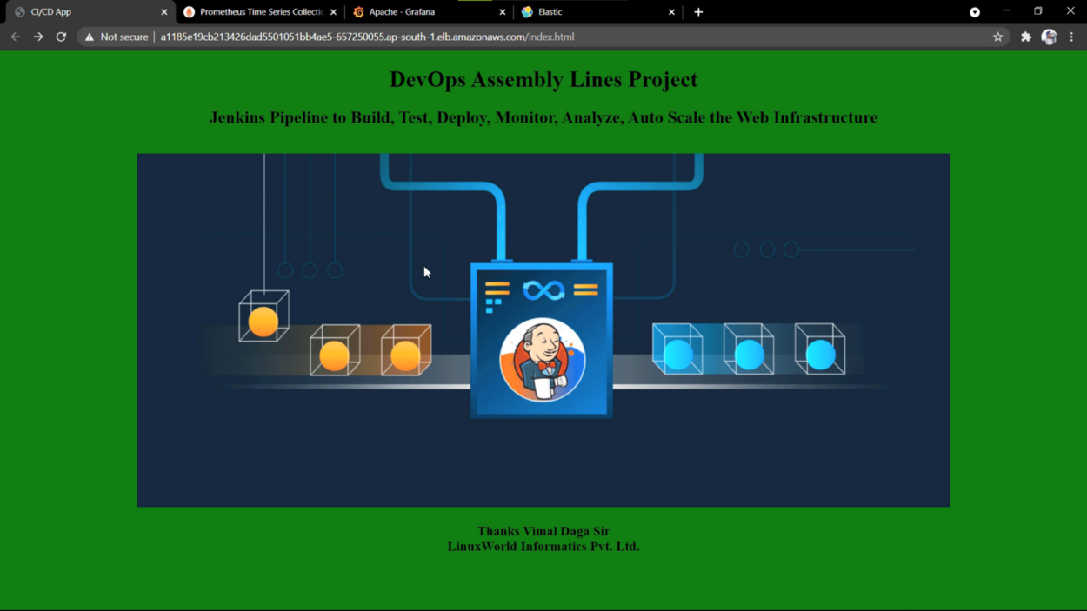
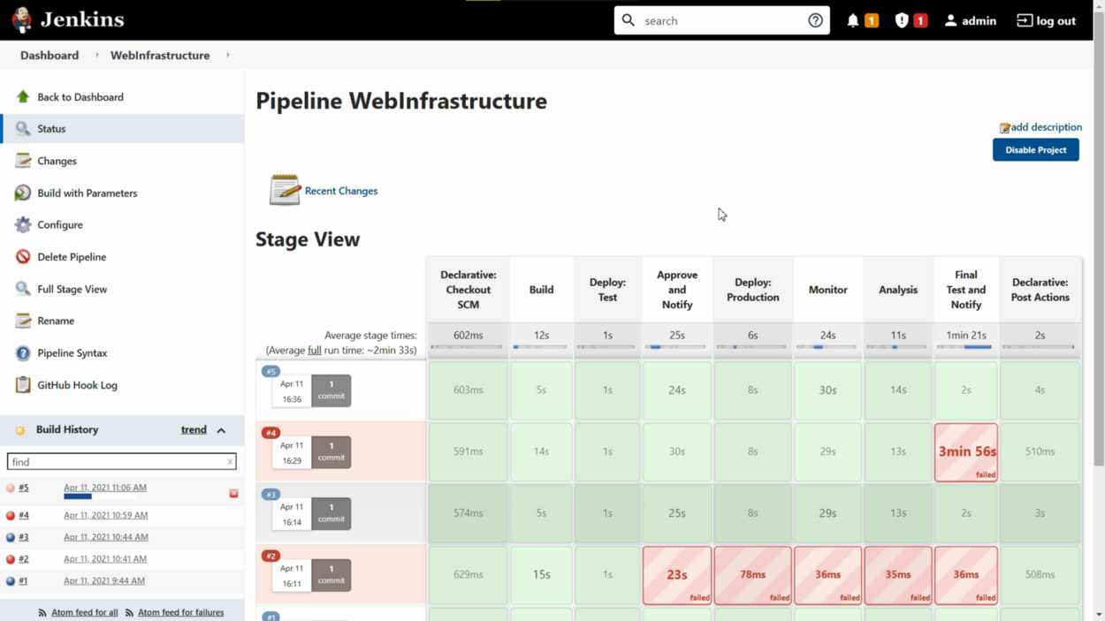
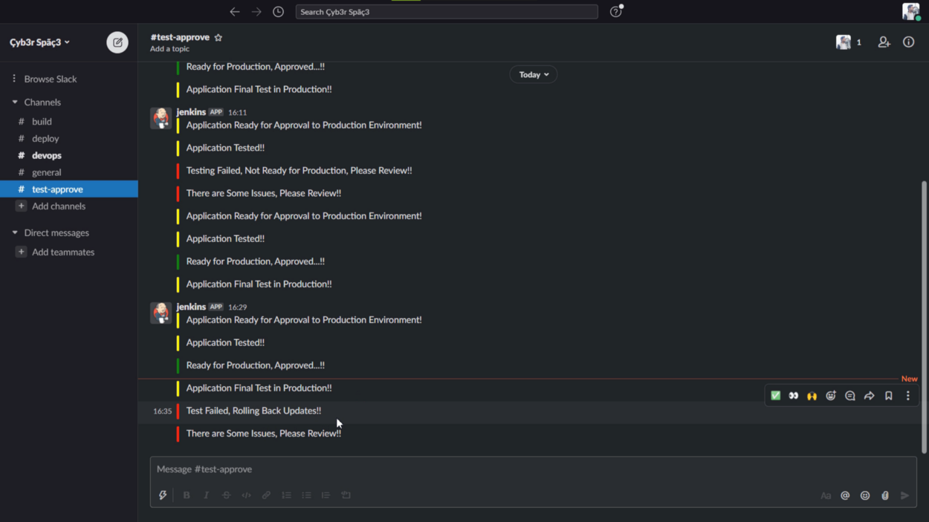
Updating the Application
After the that when developer pushes new updated code to github our pipeline will automatically gets triggered and app is updated after multiple tests.

Slide 12
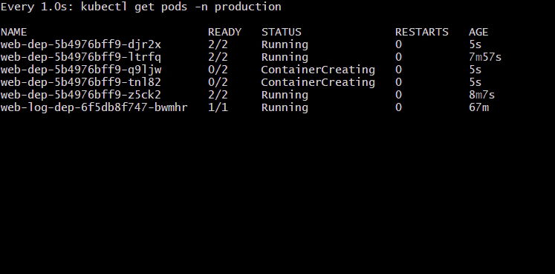
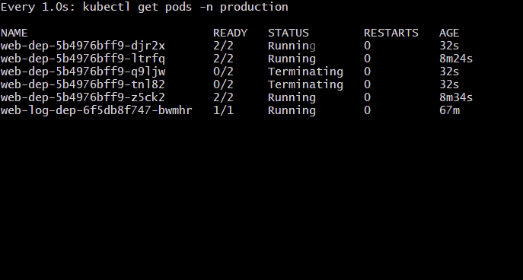
Autoscaling
Pods are autoscaled depends upon the load!

Slide 13
Conclusion
DevOps is not only important to speed up software development, but also improves the quality of the software. DevOps bring a new mindset, agile practices and smart tools which together accomplish that goal. Besides that DevOps can help with spotting of coding errors, improving communication between team members and is overall cheaper for developing software. DevOps is taking the world towards automation and reducing the human intervention. With so many benefits it is not hard to see why DevOps is the go-to choice of many IT companies.

Slide 14
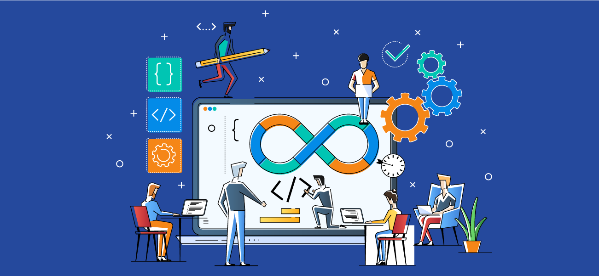
Thank You!!

